Slide 1
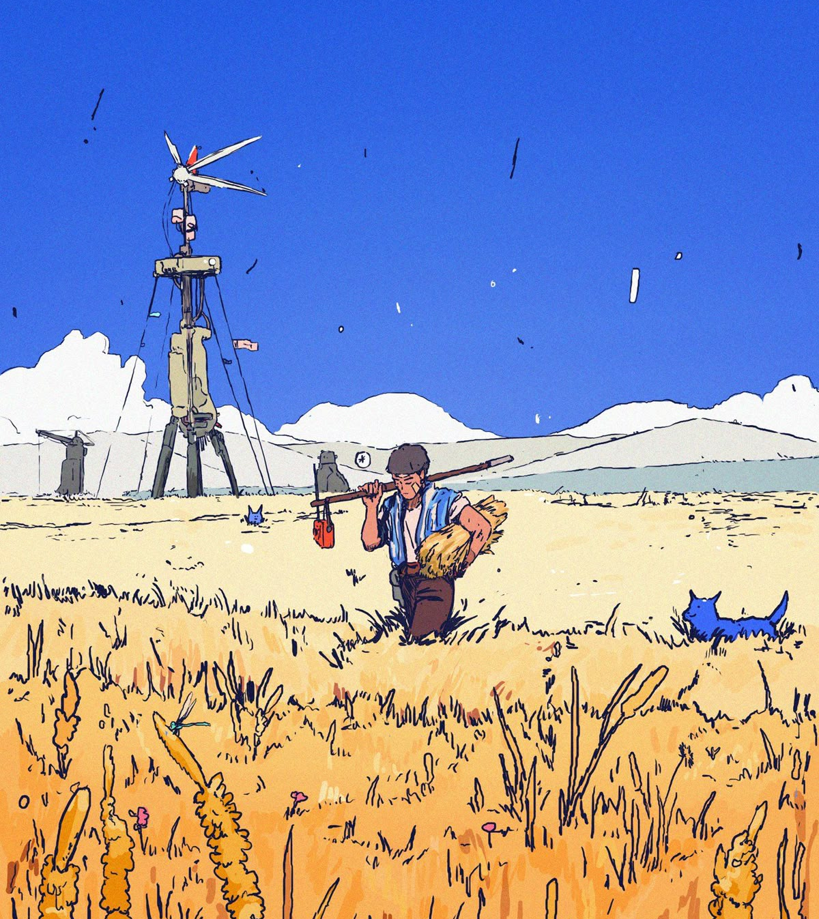
January 12, 2026
netsiege 01
sunspire

Slide 2
netsiege?
A next-generation, long-form cybersecurity competition focused on educational outcomes
An active research project
  Can cybersecurity competitions be better for students?
Pushing the needle on cybersecurity competitions
  Can we standardize and eventually, partially automate the development of competition environments?

Slide 3
Relevant Terminology
box: A virtualized server. The servers that teams will be battling for control over.
control: To “control” a box. Technically speaking, to have your team’s token in the corresponding “control files”.
control file: Files named “ctrl.txt” placed in various locations on each box. Controlling a box is equivalent to placing your team’s token in these files.
token: A unique, periodically generated token that teams can place into control files to claim control of a certain system.
phase: Each multi-week competition stage that maintains the same environment. The competition environment changes and evolves across each phase.
perspective: The public-facing scoreboard and engagement software for participants.

Slide 4
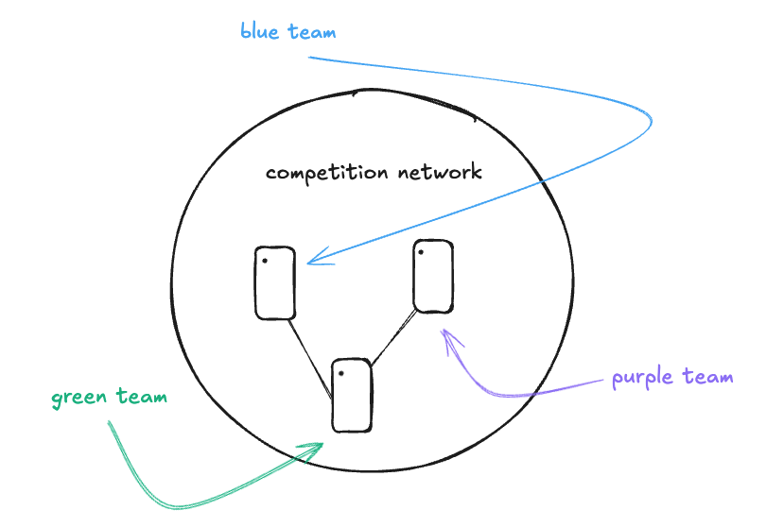
Competition Objective
At kickoff (today) you will be presented with
A competition scenario
A single network of virtualized Linux and Windows servers that host websites, file shares, APIs, microservices, and more…
There are 3 teams of 4, each representing a different faction within the competition scenario. Each team’s goal is to break into as many of these machines as possible, while keeping others out.

Slide 5
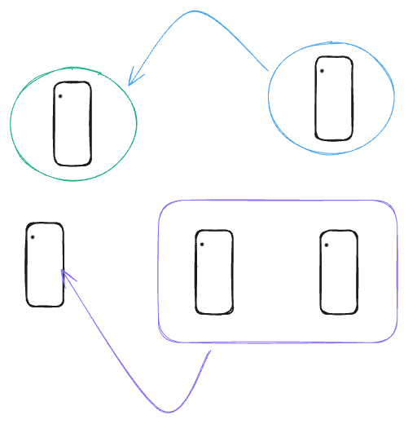
phase 1

Slide 6
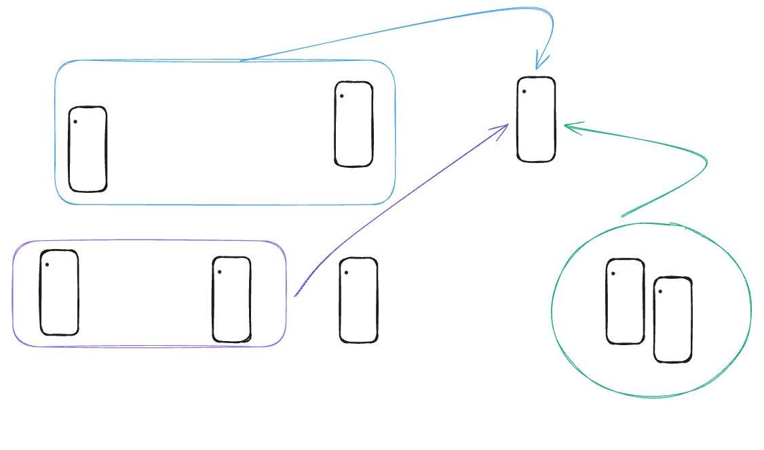
phase 2

Slide 7
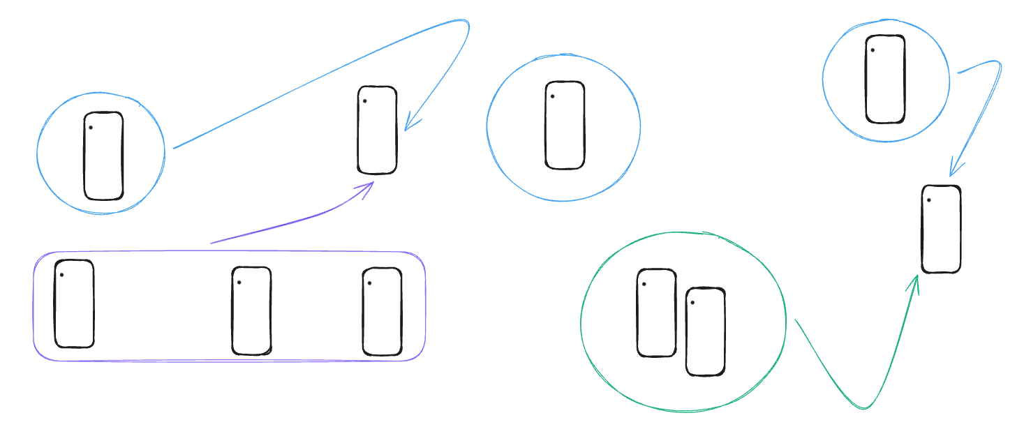
phase 3

Slide 8
Meeting Structure
Each meeting will follow the same general format:
30-40 minutes of lecture on the day’s topics
Short survey regarding competition experience
1-1.5 hours of competition times with your teams and mentor

Slide 9
timeline
phase 1
phase 3
1. Network enum + basic attacks
2. File shares
3. Basic privilege escalation
4. CVEs
1. Complete write ups
2. Submissions & wrap up
Each “phase” of the competition will last 1-3 weeks long.
Each phase will consist between 2-6 meetings or “windows” to complete. These meetings will also include curriculum that evolves with the competition environment.
Week 1
Week 2-3
Week 4-6
Week 7
kickoff
phase 2
1. netsiege introduction
2. OS fundamentals
1. Networking basics
2. Web exploitation I
3. Defense
4. Review
5. Advanced privilege escalation
6. Web exploitation II

Slide 10
Resources
Each team has access/is given the following:
netsiege discord server where participants can communicate with one another, mentors, and the organizers
Dedicated mentors with office hours each week
Lectures by the organizers or mentors every week presenting the necessary skills for the current phase

Slide 11
Today
Discuss competition scenario
Competition rules and scoring
Connecting to the environment
“Entrance exam”
Meet your team
Meet your mentors

Slide 12
Questions?

Slide 13
sunspire

Slide 14
sunspire
On a remote island, far away from most of the world, is the solarpunk city of Sunspire. A radiant forest-city that is composed of ecologically-sustainable towns that blend technology and nature. Every home, garden, and communal hall is powered by a masterfully engineered computing network that provides the essential services necessary for the society to function.
For the first time in its history, Sunspire would like to invest heavily into cybersecurity and kickstart its cyber servants program. A group responsible for ensuring the computer systems essential to Sunspire could never be destroyed. To fairly choose these newest civil servants, Sunspire is holding a tournament of strengths.

Slide 15
Tournament of strengths
Sunspire has invited world-class cybersecurity teams from around the world to compete against each other for the chance to become the very first members of the Sunspire cyber servants program. Each team will compete against each other to break into sunspire's network, stabilize it, and defend it from their competitors.

Slide 16



Canopy Accord
(team canopy)
Harmonics Group
(team harmony)
Steelbound
(team steel)

Slide 17
competition environment

Slide 18

solaris
helios
ubuntu 24.04 | 10.100.7.40
Windows Server 2022 | 10.100.7.41
File storage website, SMB, SSH
RDP
starfall
orbital
ubuntu 24.04 | 10.100.7.43
Windows Server 2022 | 10.100.7.41
System health API, SSH
MSSQL, SMB

Slide 19
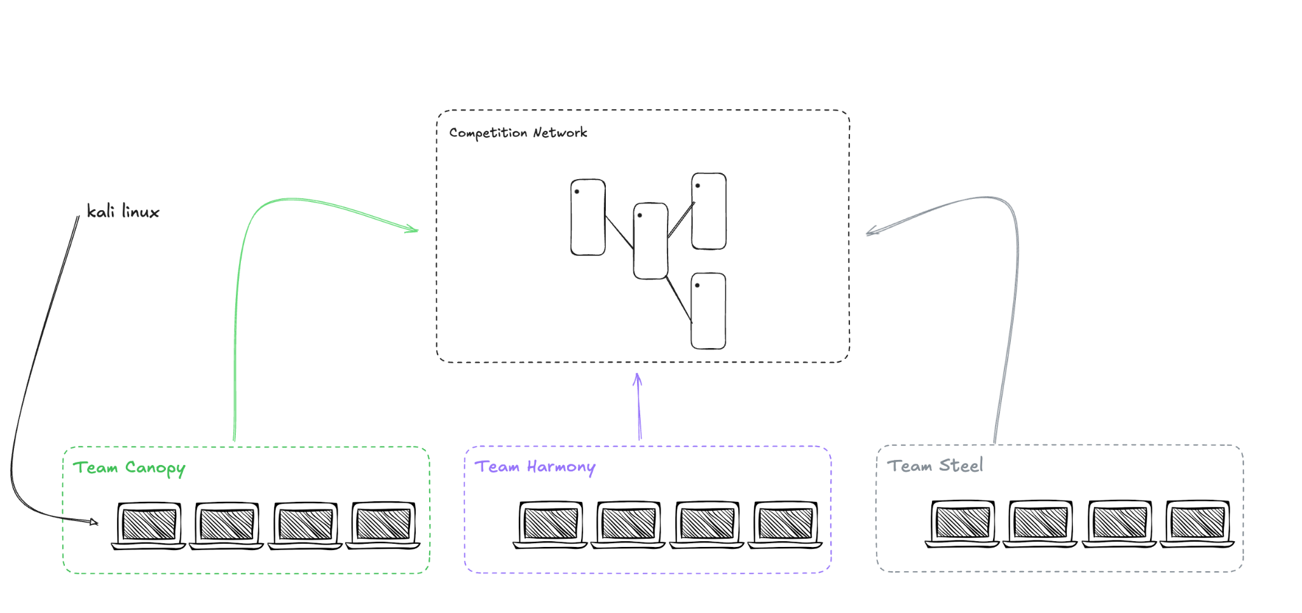

Slide 20
Competition rules
Do not attempt to access the competition network outside of official meetings and office hours.
Do not attempt to destroy or stop the “tally” service running on every machine. This service is out of scope and used for scoring.
Do not attempt to delete or move the “ctrl.txt” and “.netsiege” files on every machine. These are out of scope and used for scoring.
Do not attempt to destroy or stop existing, critical services on every machine. These services are required for sunspire to continue functioning as expected.
Do not attempt to delete or modify the “ops” user account on each machine. This account may be used for maintenance by the organizers.

Slide 21
Scoring
To “claim” a control file, place your team’s token in any “ctrl.txt” files on the system.
  The scoreboard will reflect that your team controls that machine on the next update.
  Machines can have multiple control files, the more you control the more points you are awarded.
Teams gain x points every time the scoring engine checks (every k minutes) for control.
  Generally, more points will be awarded for control over higher privileged users. (E.g. a control file captured in an administrator’s directory would be worth more points than a file accessible via a less-privileged service account)
Teams will also gain points at the end of the competition for submitting high-quality technical writeups.
  Technical writeups may include: how you exploited a specific vulnerability, how you fixed a certain vulnerability, a unique strategy you developed, and more…

Slide 22
Getting ready to play

Slide 23
Milestones
Join the Discord and update your nickname to your real name
Follow the VPN instructions at https://tinyurl.com/kru5aaev and verify that your connection is working.
Then follow the instructions in your team’s channel to connect to your kali machines

Slide 24
“Entrance exam”

Slide 25
Teams

Slide 26
If you are here
to learn?
If you are here to win…
Or just to have fun!
netsiege begins.

